Slide 1
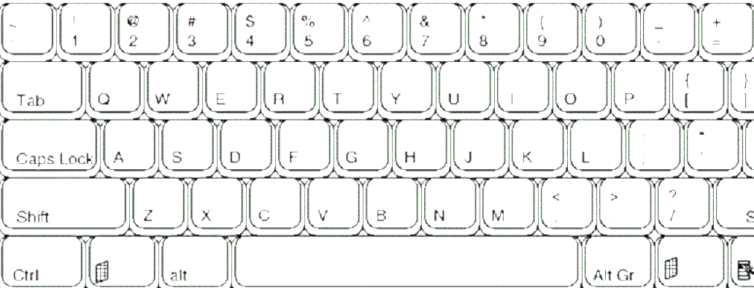
Swap Cond
Condition1 --/++
Condition2 --/++
Command --/++
Deck A -> B
Note --/++
All/None
Value1 --/++
Value2 --/++
Direct Value --/++
Channel 1 -> 2
Pad --/++
Clear grid
Close
Open
Go top
Select All
Midi Learn
Go bottom
Cut
Copy
Paste
New
CTRL
ALT
Note: bindings marked in parentheses are used with the shift key
Best parameters:
- mix cue 0%
- cue vol up
- gain –
- tick ON
Jump
A+B <-
Next+L
(Prev)
Set1
(Del1)
Set2 (Del2)
Set3
(Del3)
Set4
(Del4)
Jump
A+B ->
Play/ Pause
Cue
Zo --
(|)
Zoom ||s
Tick
(Auto)
Seek
<<-
Seek
<-
Seek
->
Seek
|
Grid <-
(<<-)
Grid ->
(->>)
Set
(Del)
BPM <-
(<<-)
BPM ->
(->>)
Play
Pause

Slide 2
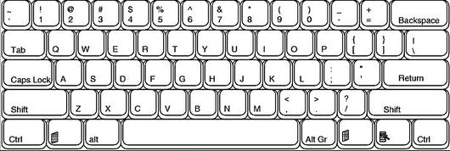

Slide 3
